Slide 1
PROJECT TITLE
CAPSTONE PROJECT
Secure Data Hiding In Images Using Steganography
Presented By: Abhilasha Bissa
Student Name : Abhilasha Bissa
College Name & Department : Mahila PG Mahavidyalaya/BCA

Slide 2
OUTLINE
Problem Statement
Technology used
Wow factor
End users
Result
Conclusion
Git-hub Link
Future scope

Slide 3
Problem Statement
As the world becomes increasingly interconnected, protecting sensitive information from unauthorized access is more critical than ever. Conventional encryption techniques, while effective, often raise suspicion due to their visible nature. To address this concern, steganography offers a stealthier solution by embedding secret messages within innocuous-looking files such as images. This approach ensures that data remains hidden in plain sight, reducing the risk of detection and maintaining the confidentiality of the information being shared. Our project explores this method, providing a secure and discreet way to communicate without alerting potential threats.

Slide 4
Technology used
Programming Language: Python
Libraries:
OpenCV for image processing
Tkinter (with ttk) for the GUI
NumPy for efficient array manipulation
Platform: Cross-platform (Windows/Linux)
Tools: Visual Studio Code

Slide 5
Wow factors
Invisible Data Security: Secret messages are hidden in images, making them undetectable to the casual observer.
Passcode Protection: Adds an extra layer of security by ensuring only authorized users can retrieve the hidden message.
No External Dependencies: The tool works without requiring complex libraries like NumPy, making it lightweight and easy to deploy.
Cross-Platform Compatibility: Works seamlessly on both Windows and Linux systems, providing versatility for various users.

Slide 6
End users
Individuals Seeking Privacy: People who want to securely communicate sensitive information without the risk of interception or detection.
Security Enthusiasts: Users who are interested in cryptography and steganography for protecting their data.
Developers & Researchers: Professionals exploring image processing, encryption, and secure communication methods for academic or practical applications.
Businesses & Enterprises: Organizations that need to safeguard confidential data shared over untrusted channels, such as customer information or internal communications.
Governments & Agencies: Entities requiring covert channels for communication in sensitive environments to avoid potential threats or surveillance.

Slide 7

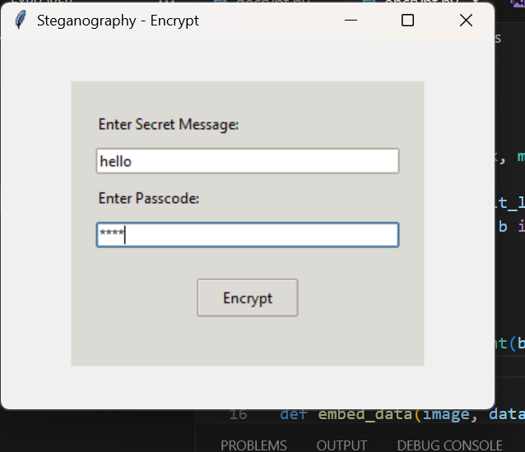
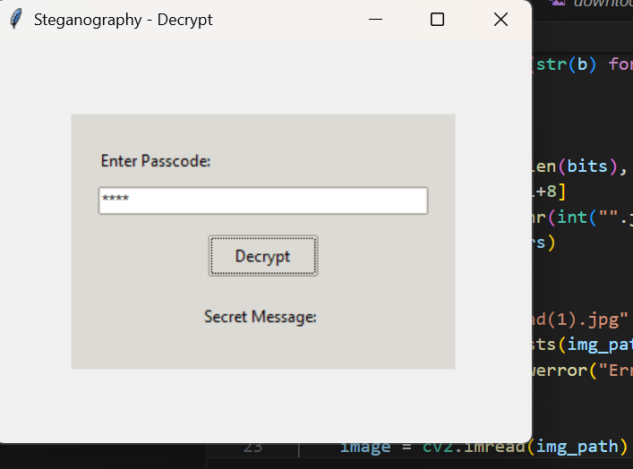
Results

Slide 8
Conclusion
SteganoCrypt provides an innovative and secure solution for hiding secret messages within images, offering enhanced confidentiality through the technique of steganography. By utilizing passcode protection and LSB encoding, it ensures that only authorized users can access the hidden information, while leaving the original image intact and undetectable. The tool is user-friendly, fast, and works seamlessly across multiple platforms, making it suitable for a wide range of users, from individuals to businesses and government agencies. With no external dependencies, SteganoCrypt offers a lightweight and efficient way to communicate covertly. As an open-source project, it invites collaboration and further development within the security community, making it a valuable resource for anyone seeking to safeguard their sensitive data.

Slide 9
GitHub Link
https://github.com/AbhilashaBissa/Project.git

Slide 10
Future scope(optional)
The future of SteganoCrypt holds significant potential for expansion and enhancement. In the coming versions, the tool could integrate advanced encryption algorithms to further secure hidden messages, making it more robust against potential threats. Additionally, incorporating AI-based detection prevention could make the tool even harder to detect, ensuring a higher level of security. There’s also the possibility of integrating the tool with cloud storage systems, allowing users to securely store and share encrypted images across platforms. Furthermore, support for more file formats and multi-layered steganography could be explored to increase flexibility and offer more options for secure communication. As data security concerns continue to grow, SteganoCrypt has the potential to become a leading solution for covert data protection.

Slide 11
THANK YOU

